Slide 1
Water Chemistry Correlations in Santa Cruz Island, Galapagos: An R Studio Visual Analysis
Kendall greer

Slide 2
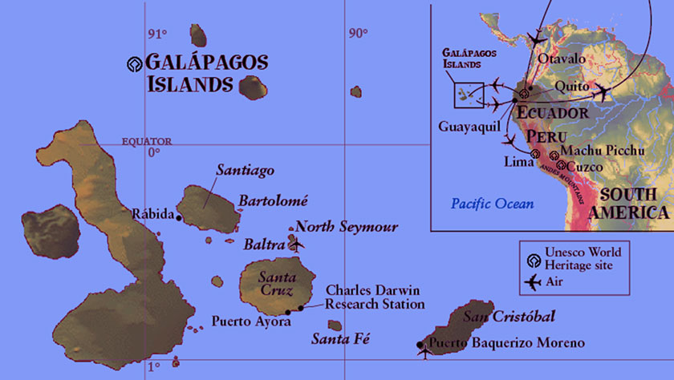
The Galapagos Islands
Sampling performed on Santa Cruz, Isabela, and San Cristobol
This Photo by Unknown Author is licensed under CC BY-NC

Slide 3
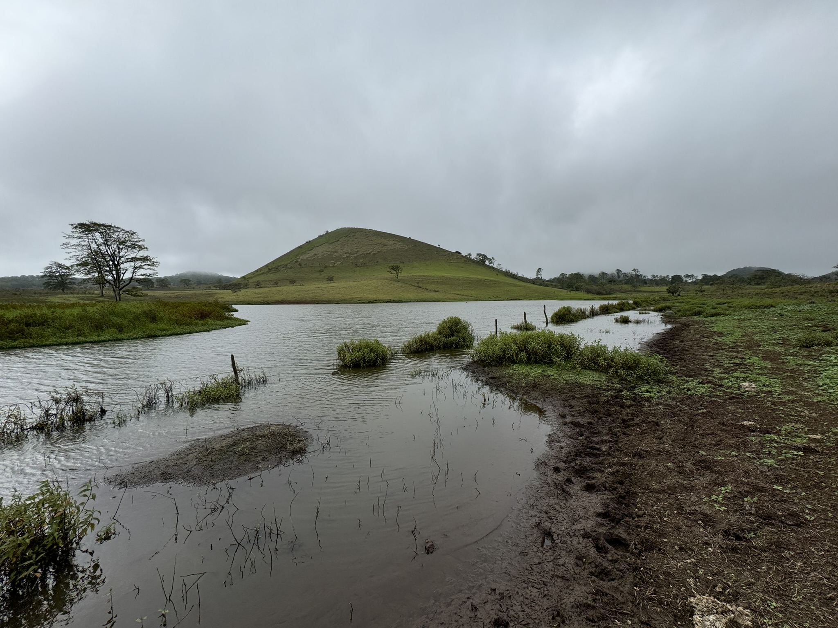
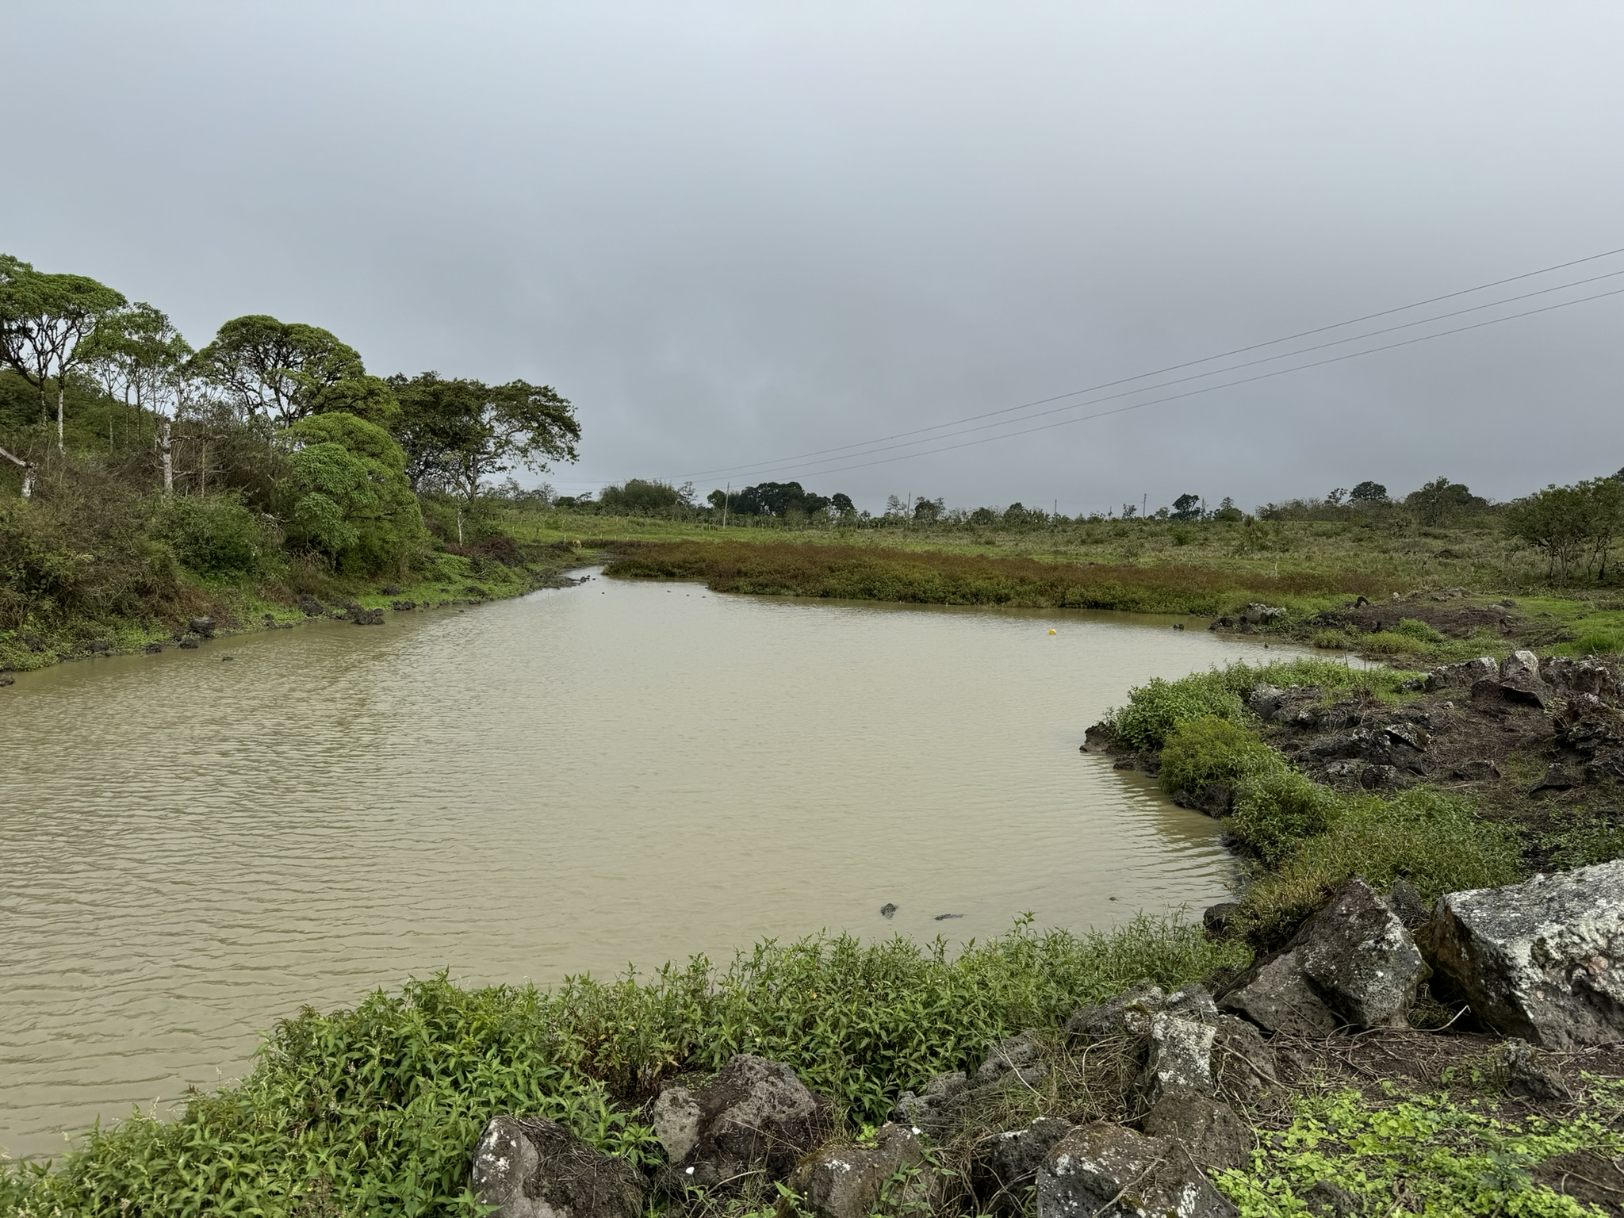
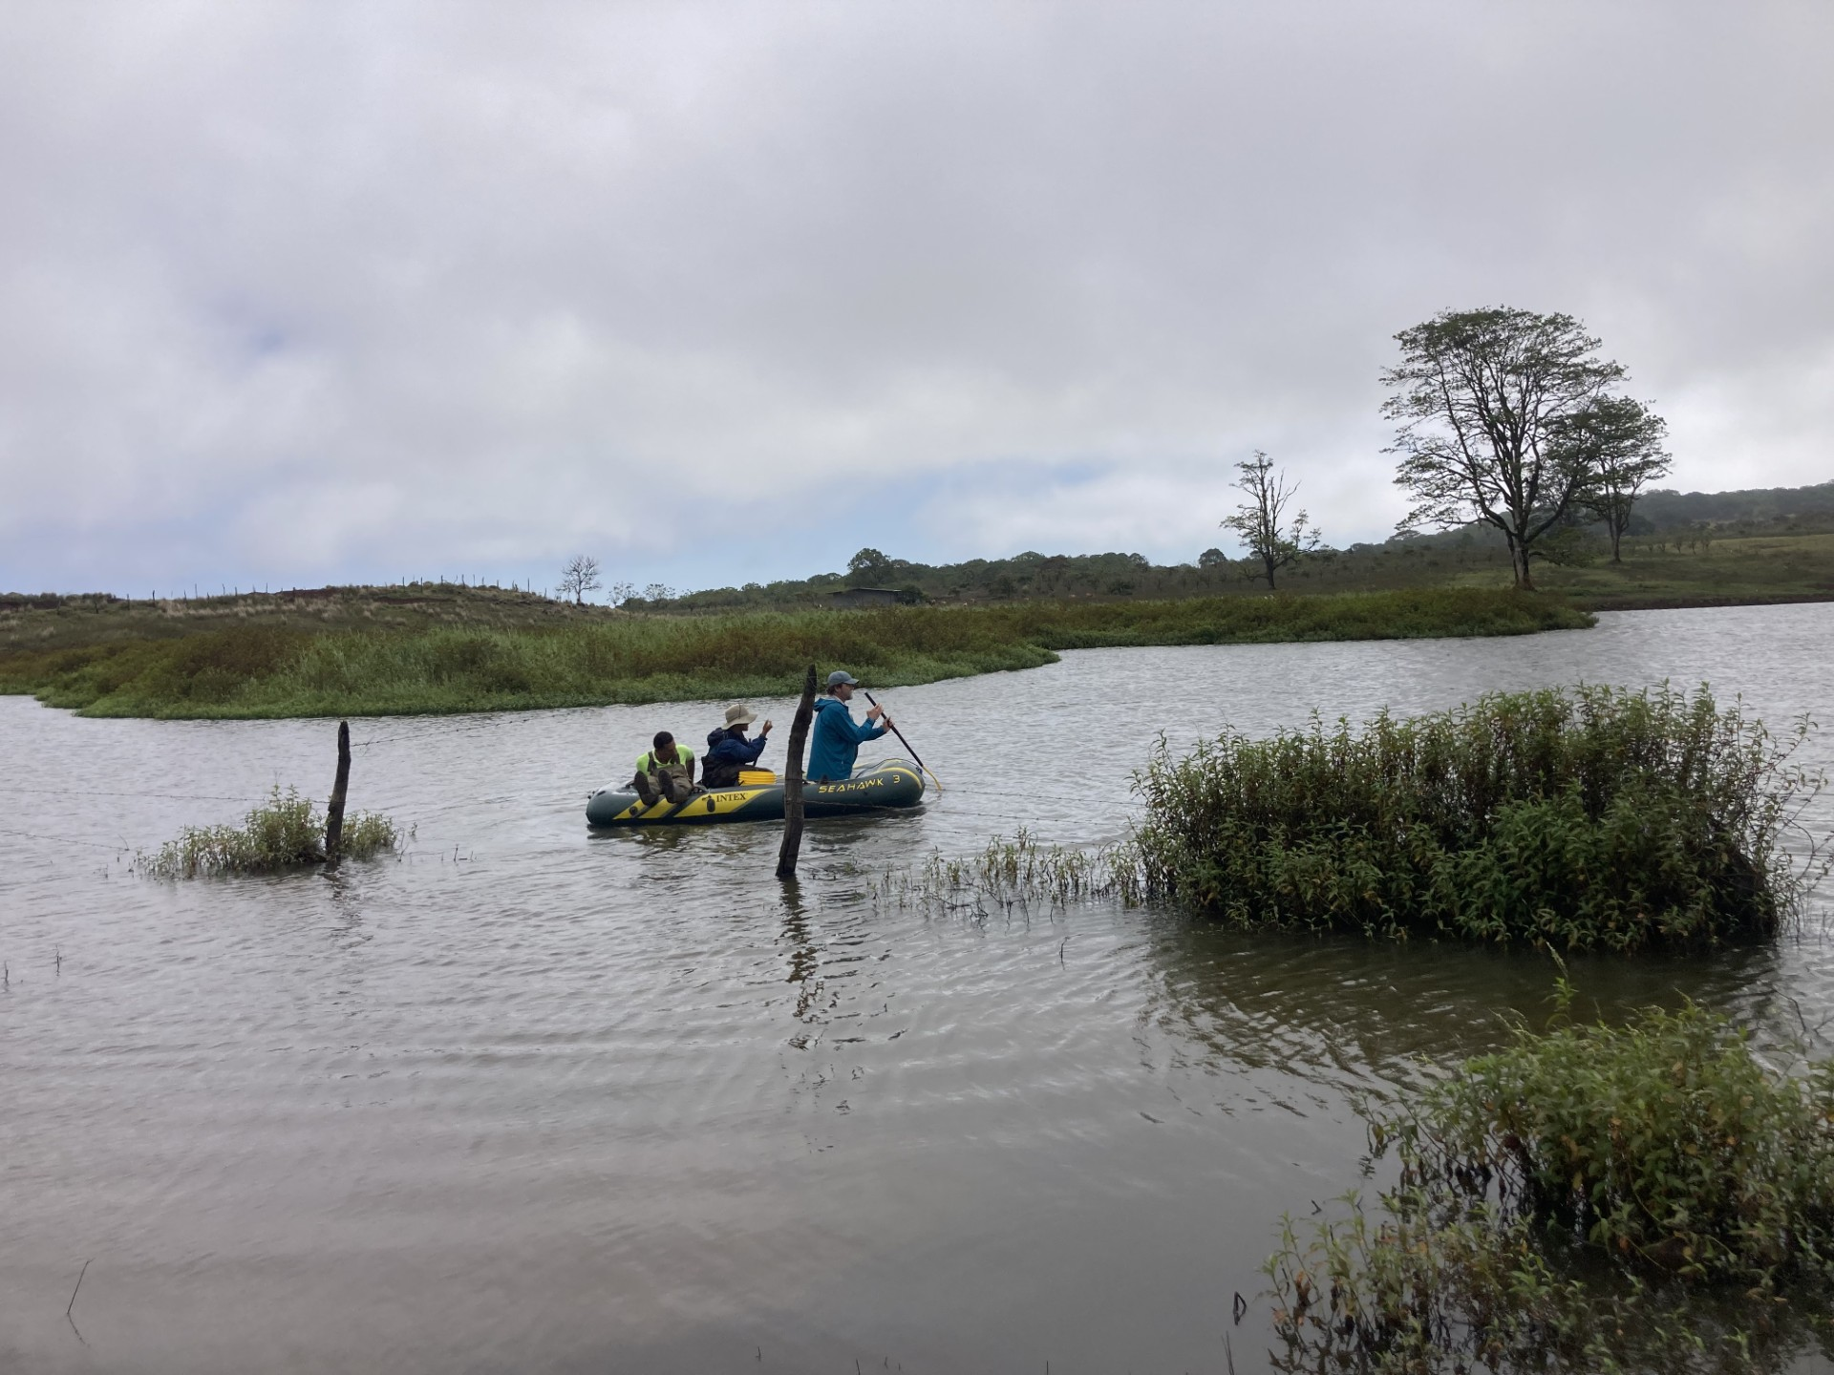
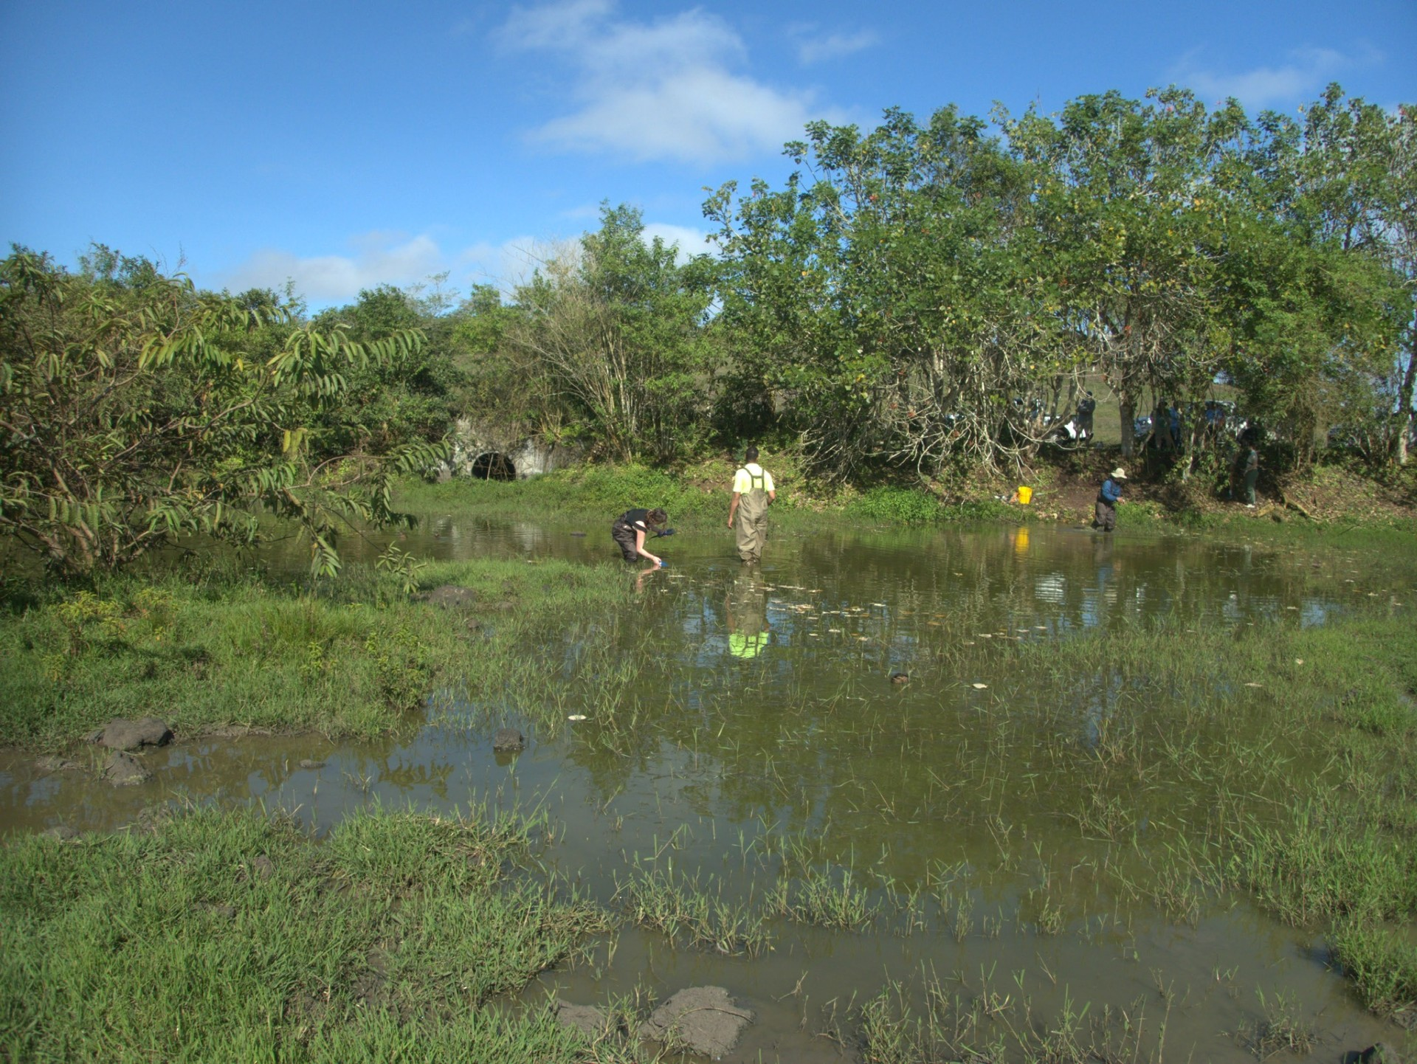
Santa Cruz Island
Laureles
Cerro Mesa
Cascajo

Slide 4
To assess water chemistry patterns and correlations, I created 3 visualizations looking at 4 specific parameters: Dissolved Oxygen Percent, pH, Specific Conductivity, and Temperature
Temporal Patterns
Temporal fluctuations of individual parameters over 24 hours using ggplot and patchwork
Correlations Between Parameters
A linear regression showing the relationship between parameters using ggplot and patchwork
Combined Diel Correlations
Diel fluctuations of multiple parameters for visualization of correlative patterns using plotly

Slide 5
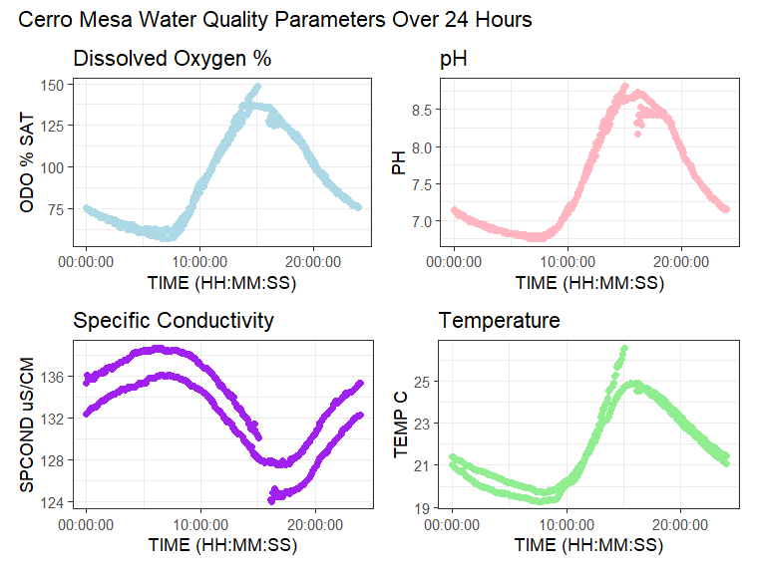
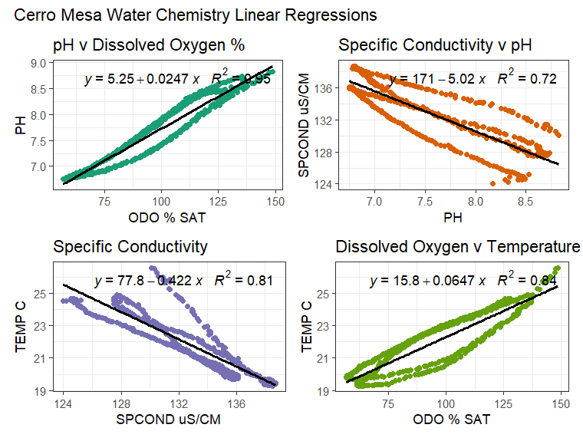
Cerro Mesa Water Chemistry Patterns

Slide 6
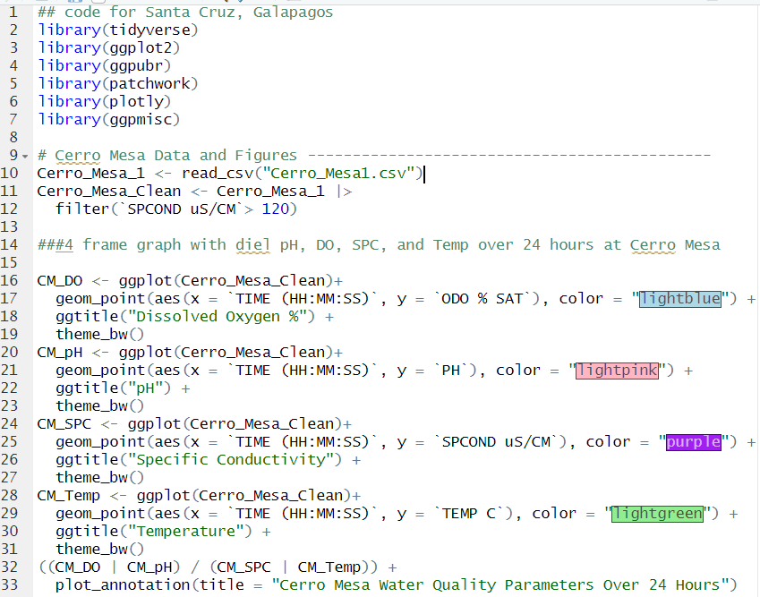
Cerro Mesa Code For Individual Diel Patterns

Slide 7
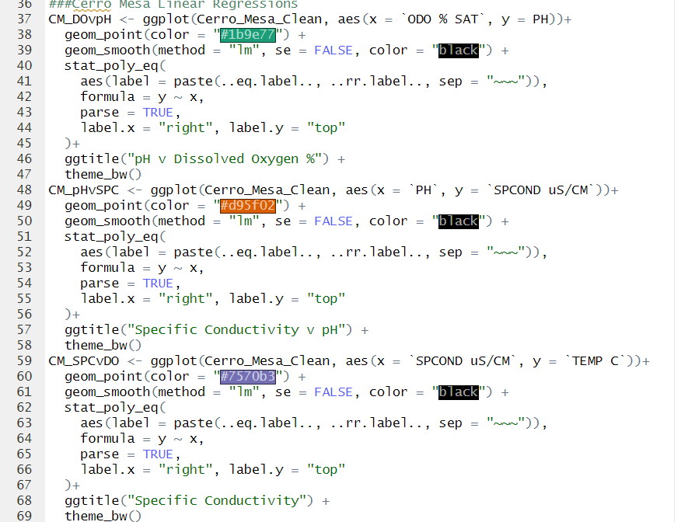
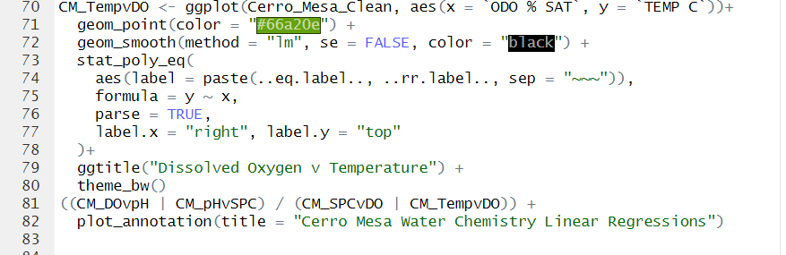
Cerro Mesa Code For Linear Regressions Showing Parameter Correlations

Slide 8
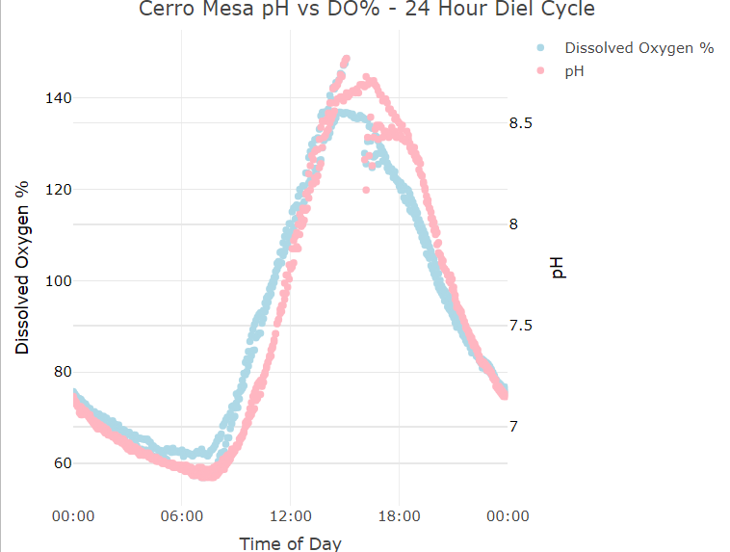
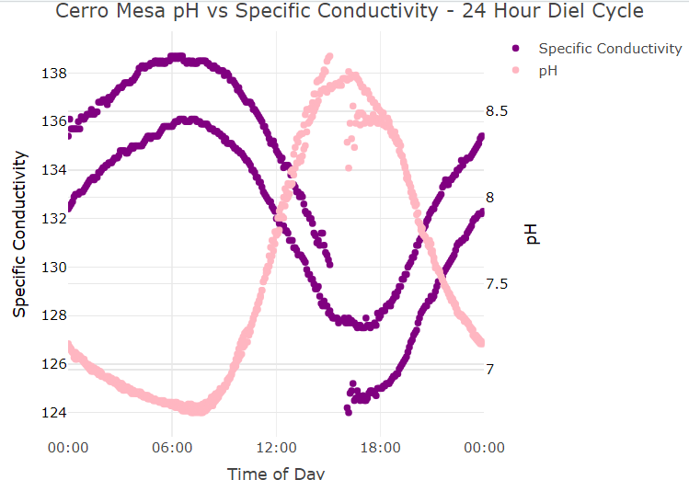
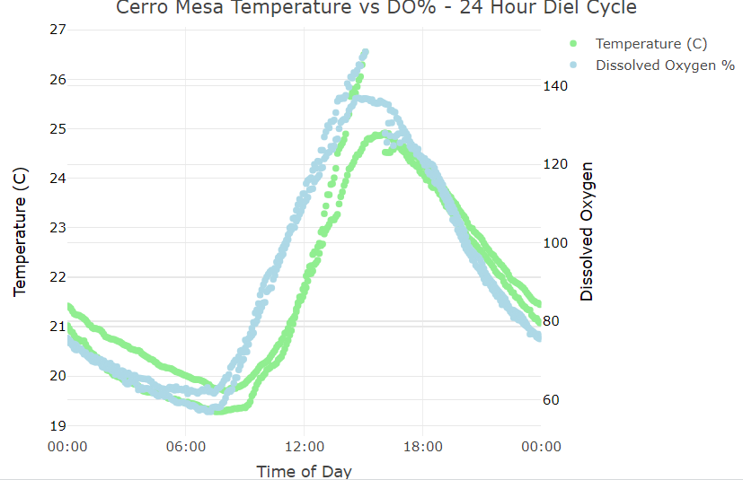
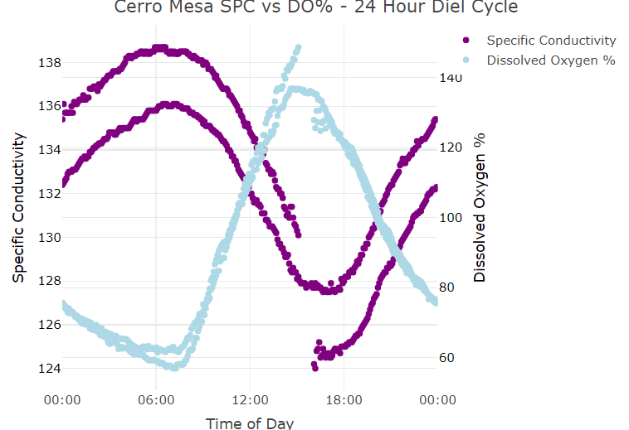
Santa Cruz Diel Comparisons Using Plotly

Slide 9
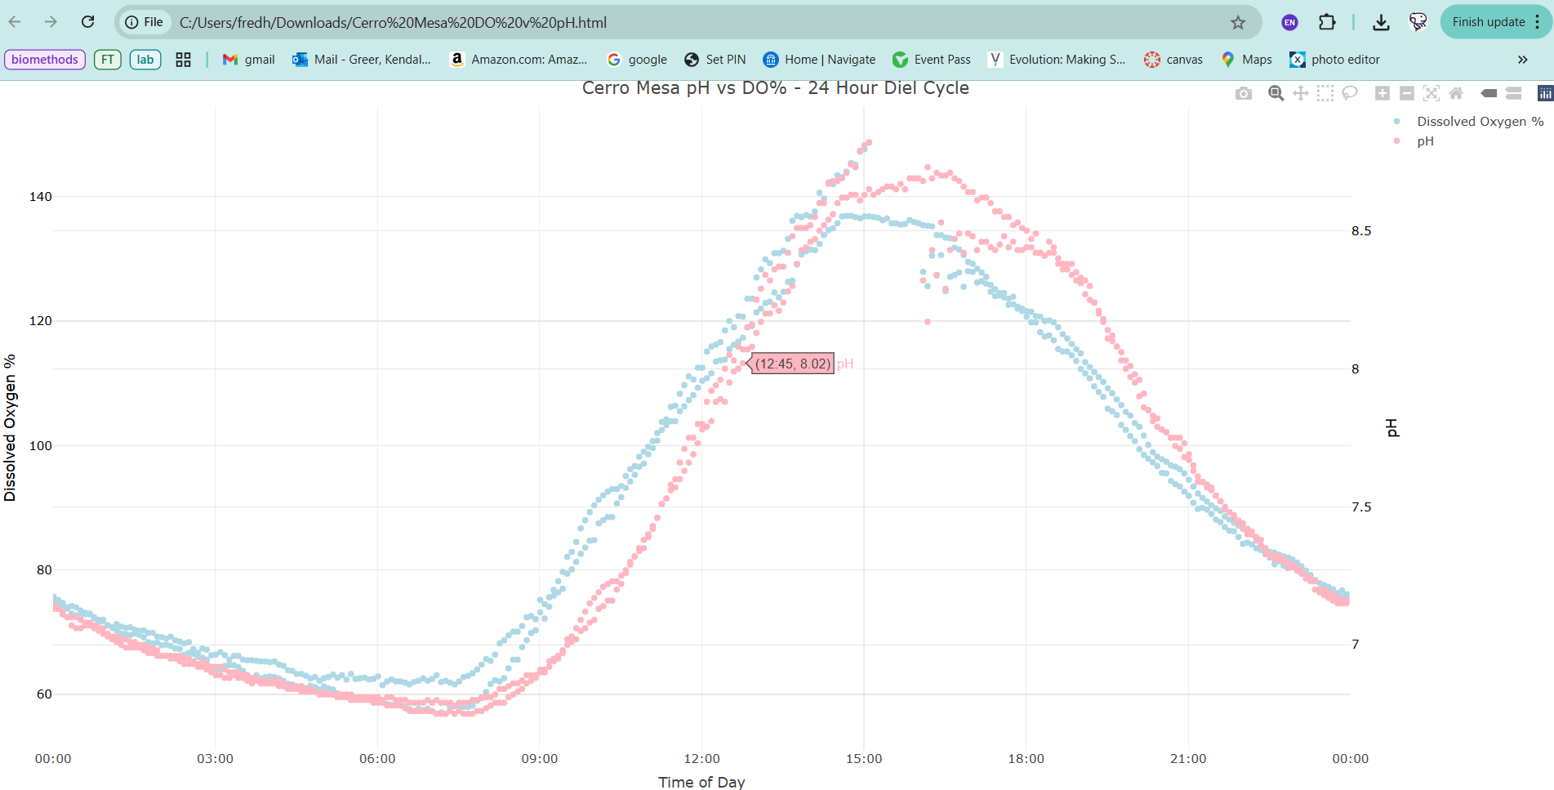
Why Plotly?

Slide 10
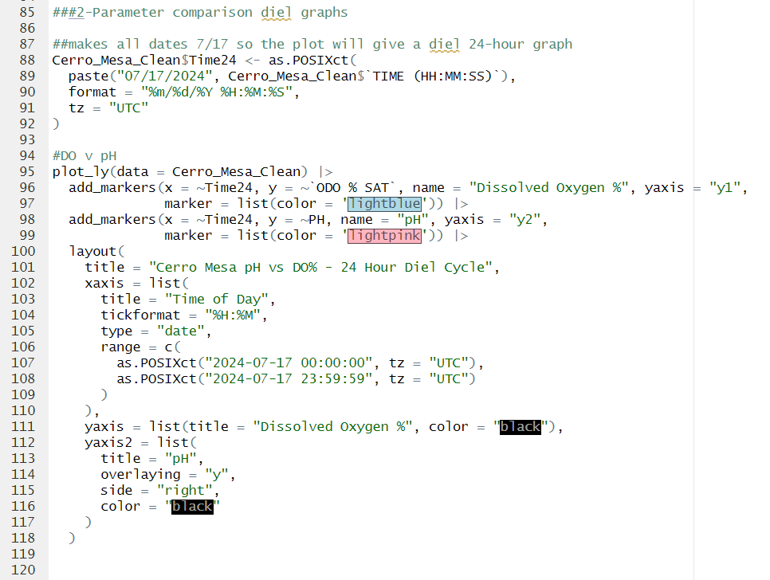
Cerro Mesa Code For Two- Parameter Diel Comparisons

Slide 11
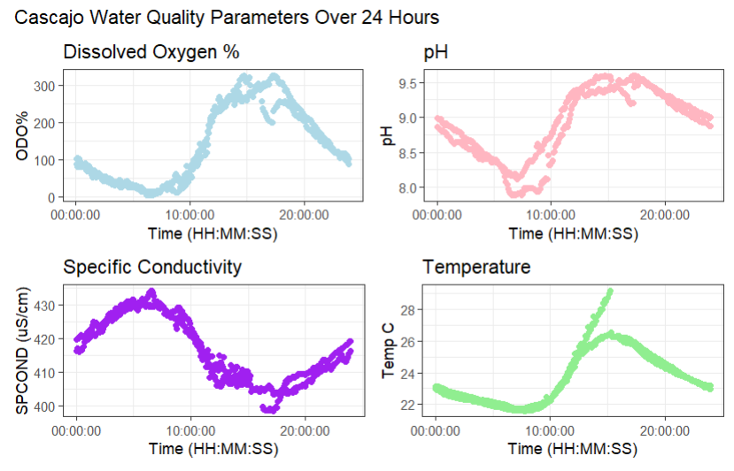
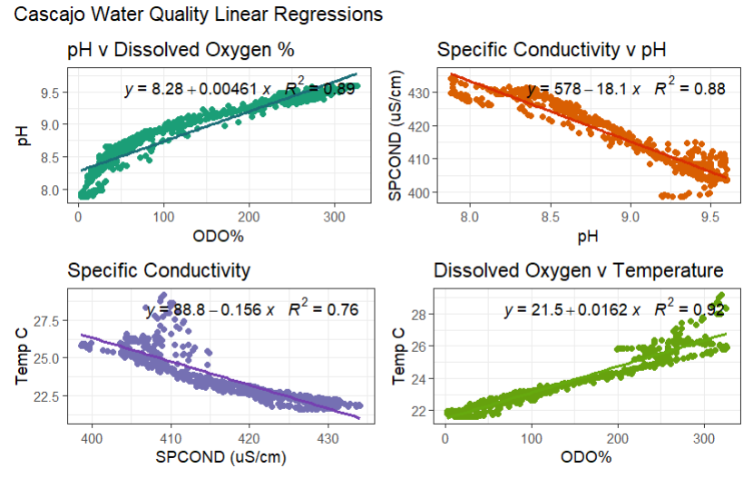
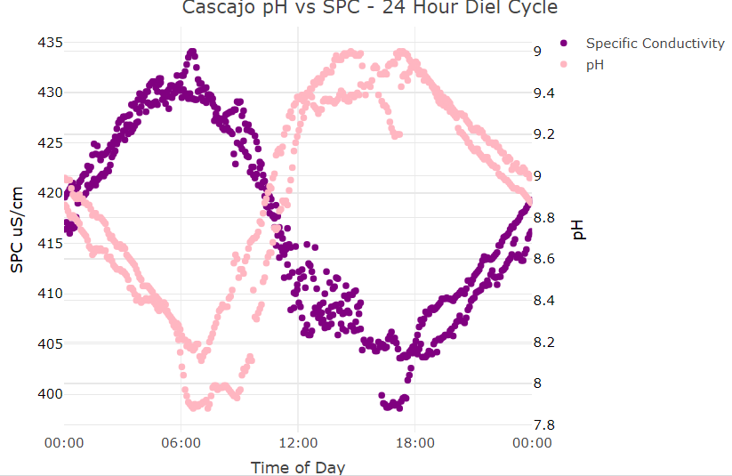
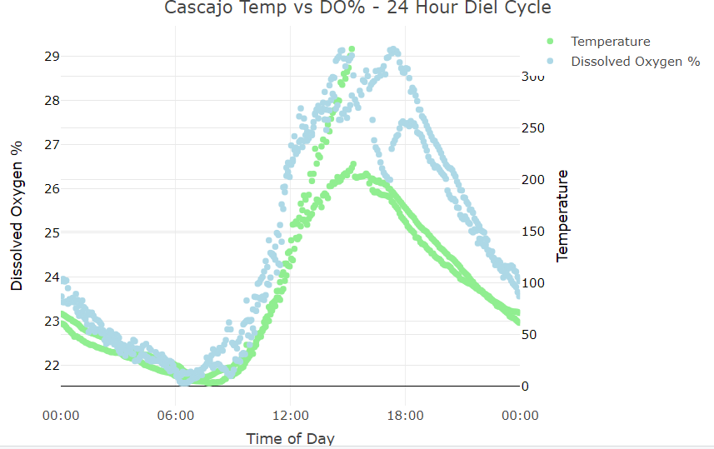
Using slightly altered code, the same figures were created to assess water chemistry in Cascajo:

Slide 12
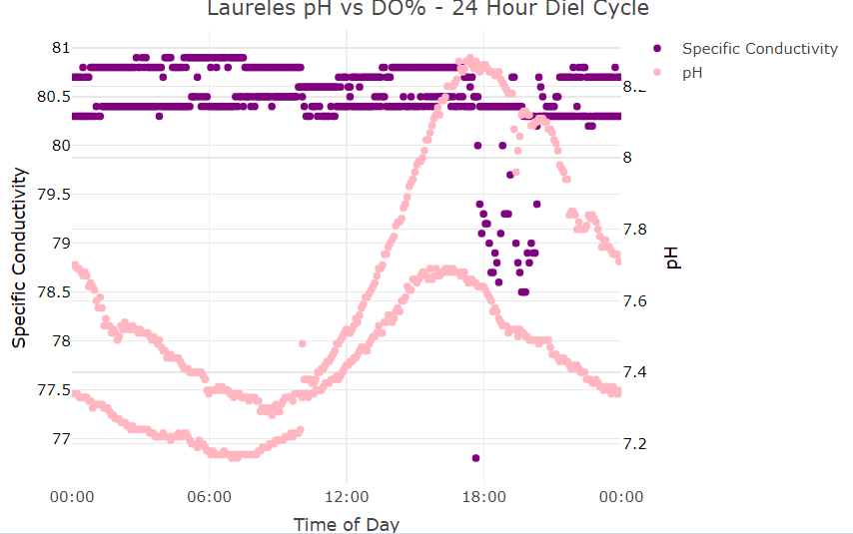
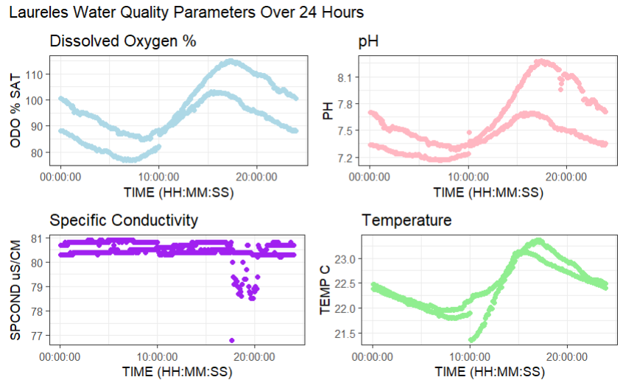
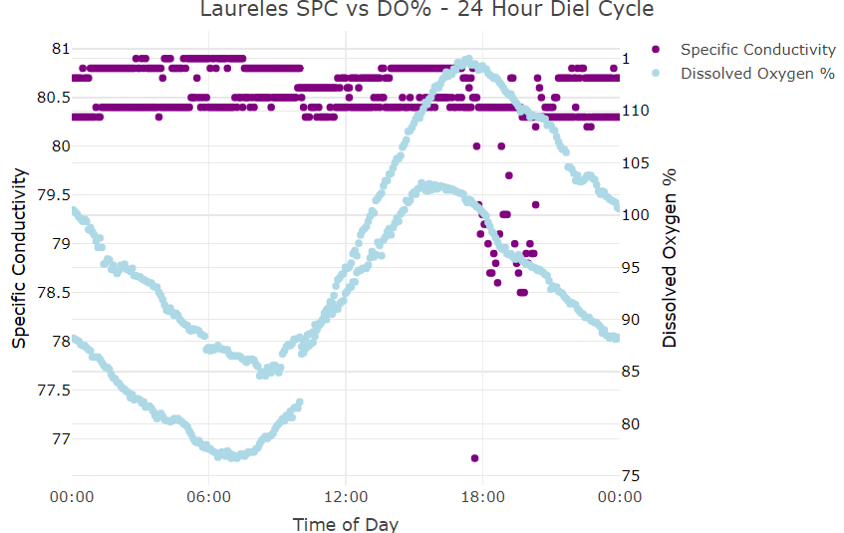
…And Laureles
Specific conductivity did not follow patterns observed at our other two sites

Slide 13
Future Directions
Collect water samples to check for dissolved gasses and nutrients
May explain the variation seen in specific conductivity across sites
Incorporate data from other islands
Freshwater bodies on San Cristobol and High salinity lakes and ponds on Isabela
Increase accessibility
Create a more concentrated database where all interactive Plotly plots are available

Slide 14
References
Andersen, M. R., Kragh, T., & Sand-Jensen, K. (2017-9-13). Extreme diel dissolved oxygen and carbon cycles in shallow vegetated lakes. Proceedings of the Royal Society B: Biological Sciences, 284(1862). https://doi.org/10.1098/rspb.2017.1427
GeeksforGeeks. 2024. Getting Started with Plotly in R. GeeksforGeeks. From www.geeksforgeeks.org/getting-started-with-plotly-in-r/
Liang, X., Jian, Z., Tan, Z., Dai, R., Wang, H., Wang, J.,…Li, T. (2024-10-29). Dissolved Oxygen Concentration Prediction in the Pearl River Estuary with Deep Learning for Driving Factors Identification: Temperature, pH, Conductivity, and Ammonia Nitrogen. Water 2024, Vol. 16, Page 3090, 16(21). https://doi.org/10.3390/w16213090
R Core Team. 2024. R: A Language and Environment for Statistical Computing. from https://www.r-project.org/
Reddy, K. R., & Reddy, K. R. (1981-12-01). Diel variations of certain physico-chemical parameters of water in selected aquatic systems. Hydrobiologia 1981 85:3, 85(3). https://doi.org/10.1007/BF00017610
Slater, L. J., Thirel, G., Harrigan, S., Delaigue, O., Hurley, A., Khouakhi, A.,…Smith, K. (2019/07/12). Using R in hydrology: a review of recent developments and future directions. Hydrology and Earth System Sciences, 23(7). https://doi.org/10.5194/hess-23-2939-2019
Wong, M.-F., Guo, S., Hang, C.-N., Ho, S.-W., Tan, C.-W., Wong, M.-F.,…Tan, C.-W. (2023-06-01). Natural Language Generation and Understanding of Big Code for AI-Assisted Programming: A Review. Entropy 2023, Vol. 25, Page 888, 25(6). https://doi.org/10.3390/e25060888

